Slide 1

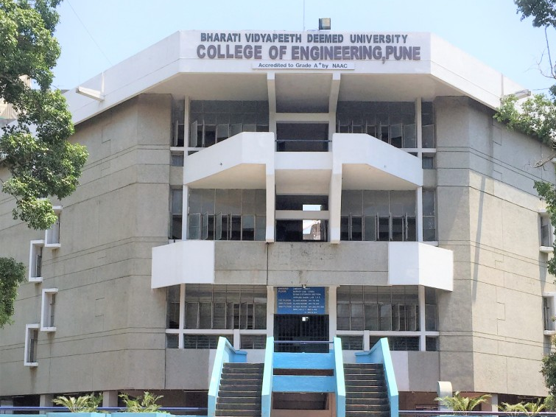

BHARATI VIDYAPEETH DEEMED UNIVERSITY
COLLEGE OF ENGINEERING , PUNE
Human following robot
DEPARTMENT OF
ROBOTICS AND AUTOMATION
SUBMITTED BY:
Shivani (Rollno.30)
Rohit Patil (Rollno.24)
Gauri Kadbane(Rollno.11)
Anand Patil(Rollno.25)
SUBMITTED TO:
Mr. Pradeep V. Jadhav

Slide 2
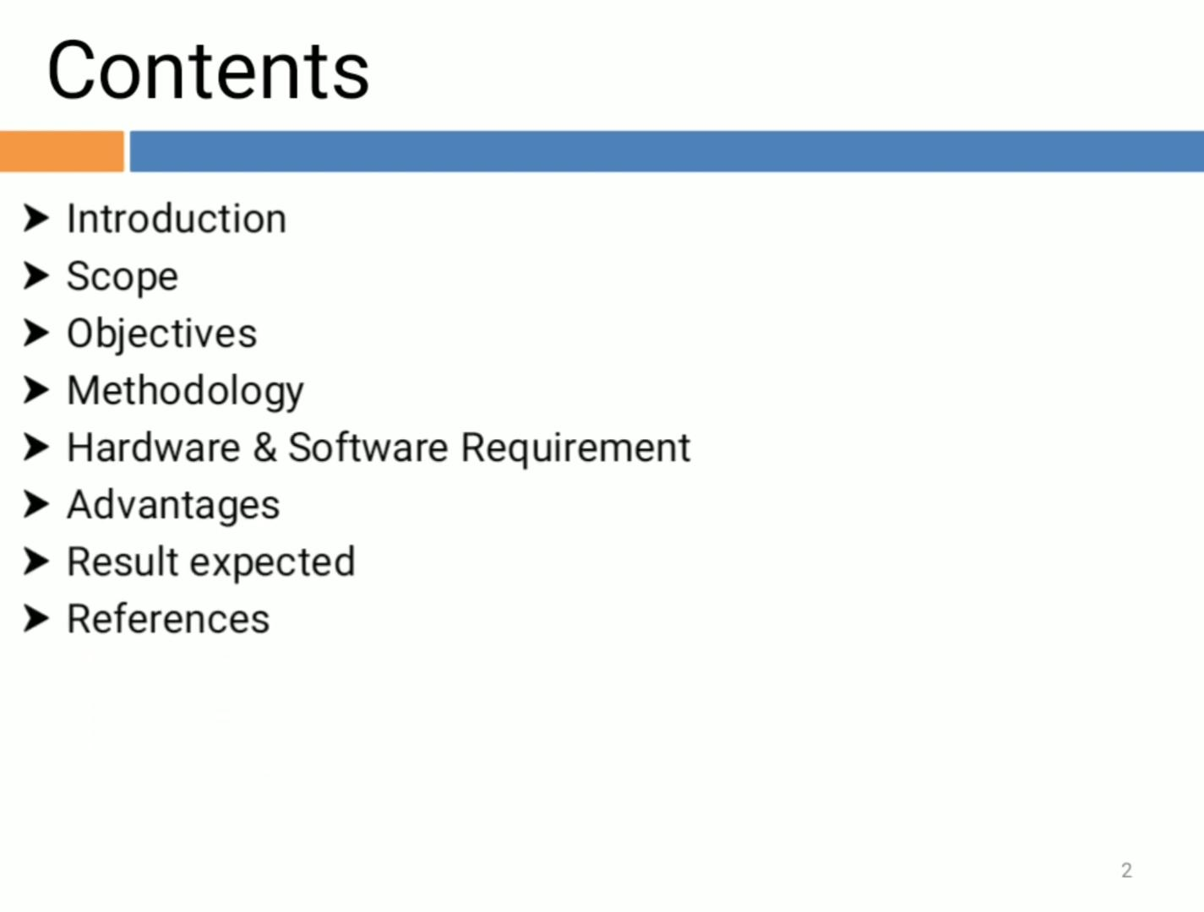

introduction
Ansys Mechanical finite element analysis software
to simulate computer models of structures for analyzing the strength toughness, elasticity, temperature distribution, electromagnetism, fluid flow, and other attributes.
to determine how a product will function.

Slide 3
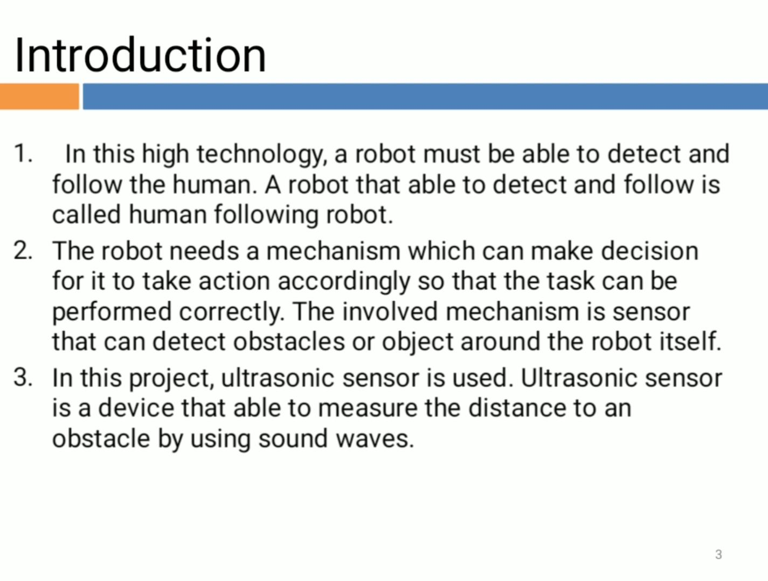
topic
Mini ANSYS software
to find displacement solution of small problems
Here we are with idea of Analysis of Spring , Bar , and Bar element with different material .
Will perform using MATLAB Simulink

Slide 4
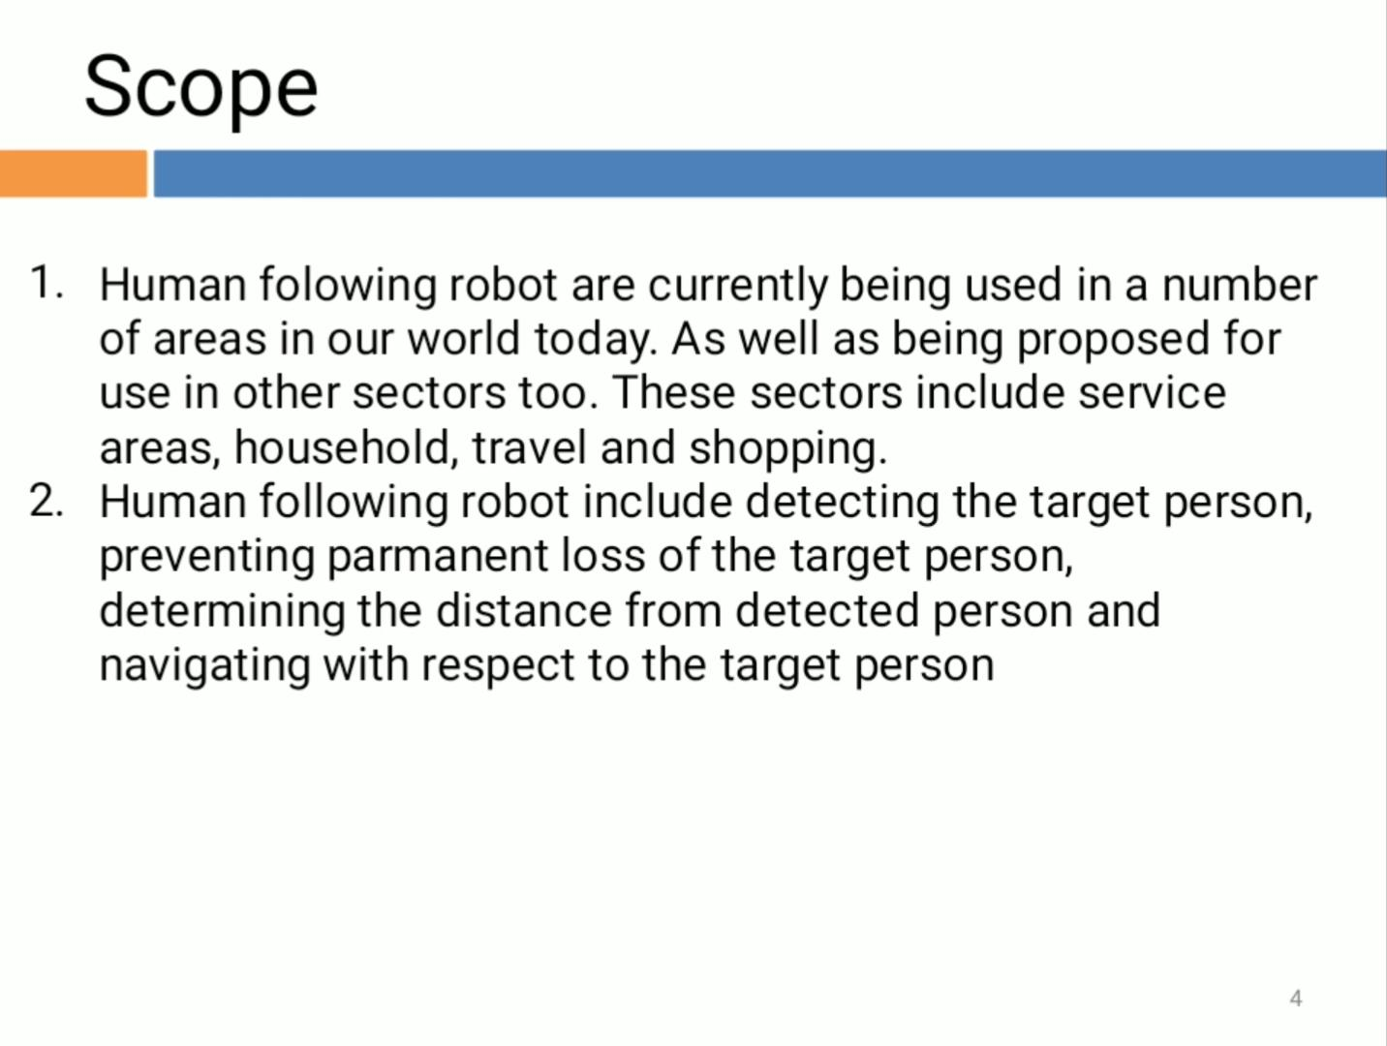
About simulink
Is a block diagram environment for multidomain simulation and Model-Based Design.
supports system-level design, simulation, automatic code generation, and continuous test and verifications.
provides a graphical editor, customizable block libraries, and solvers for modeling .

Slide 5
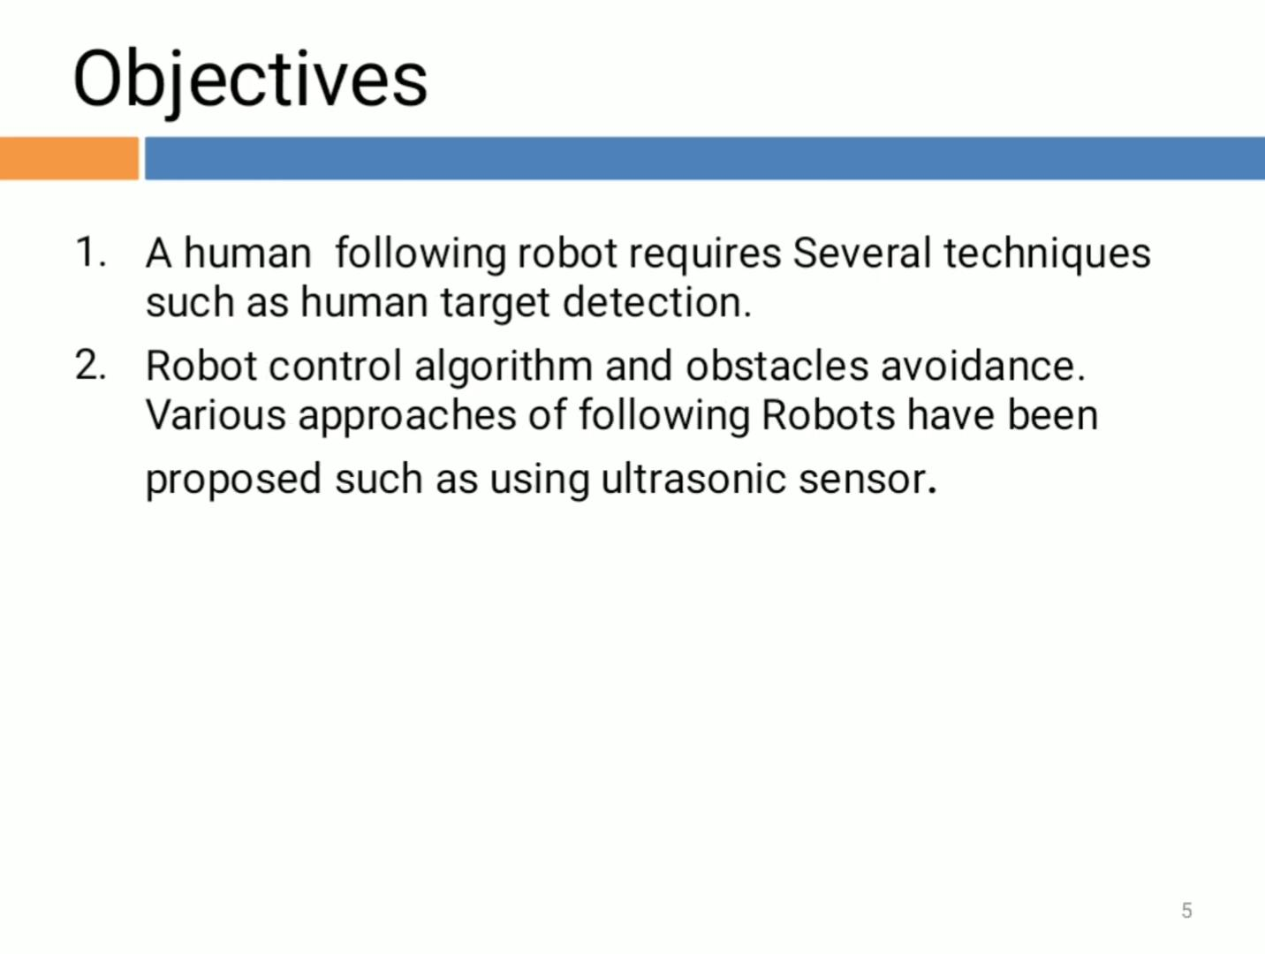
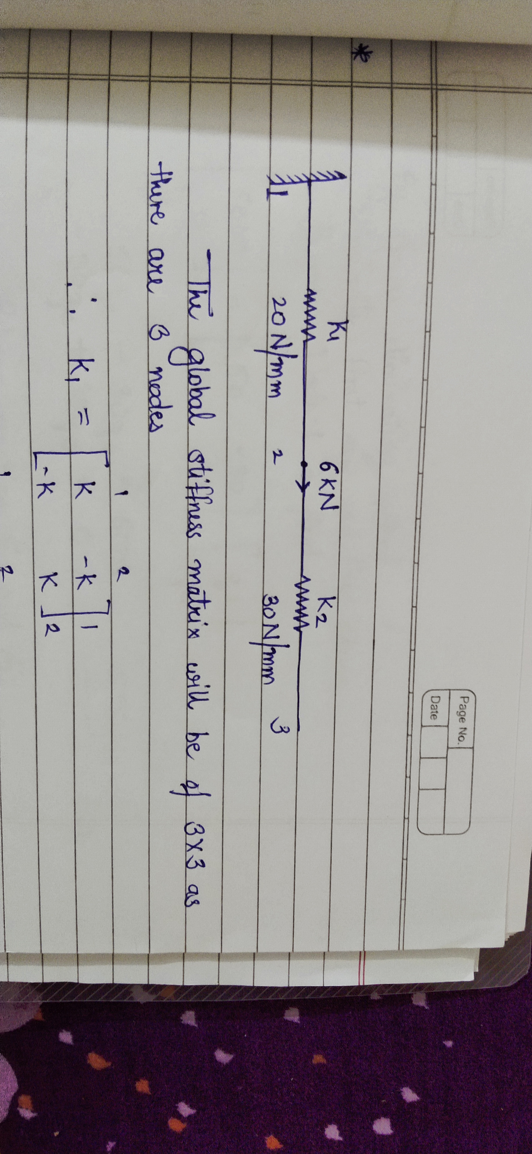
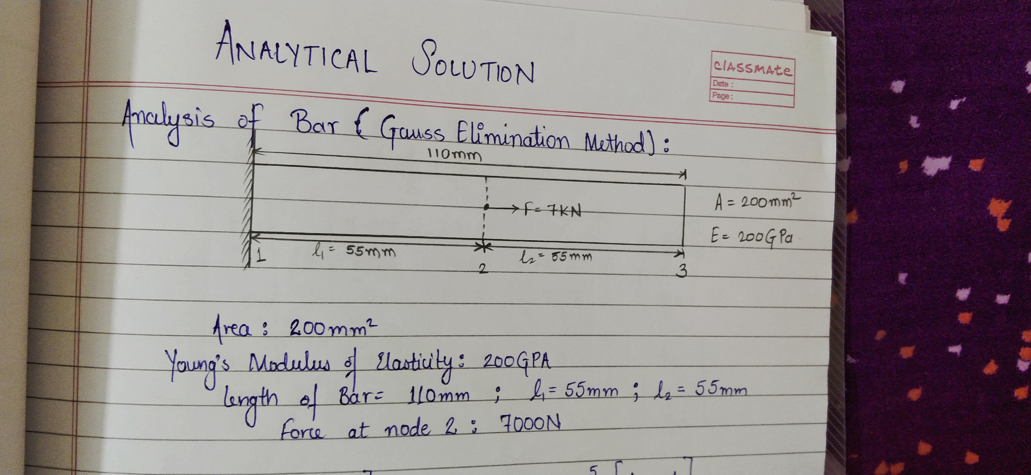
diagrams

Slide 6
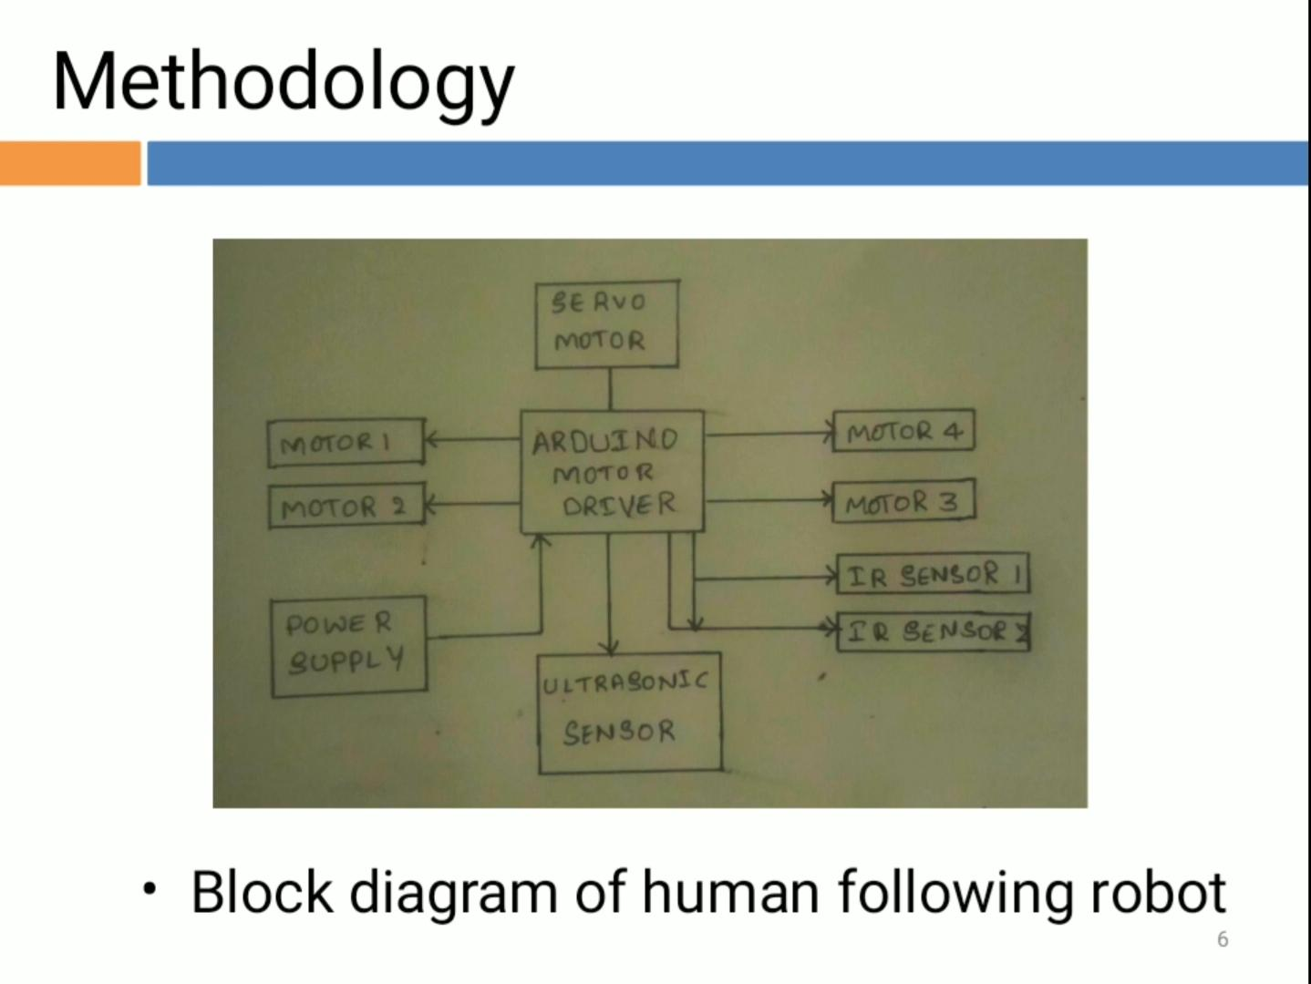
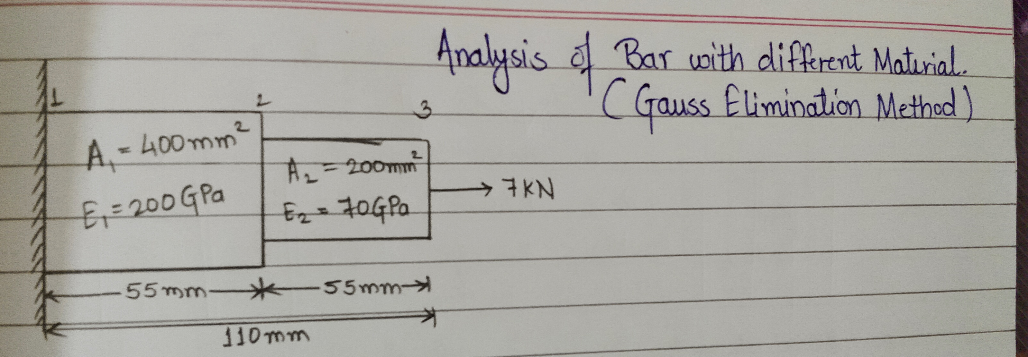
diagrams

Slide 7
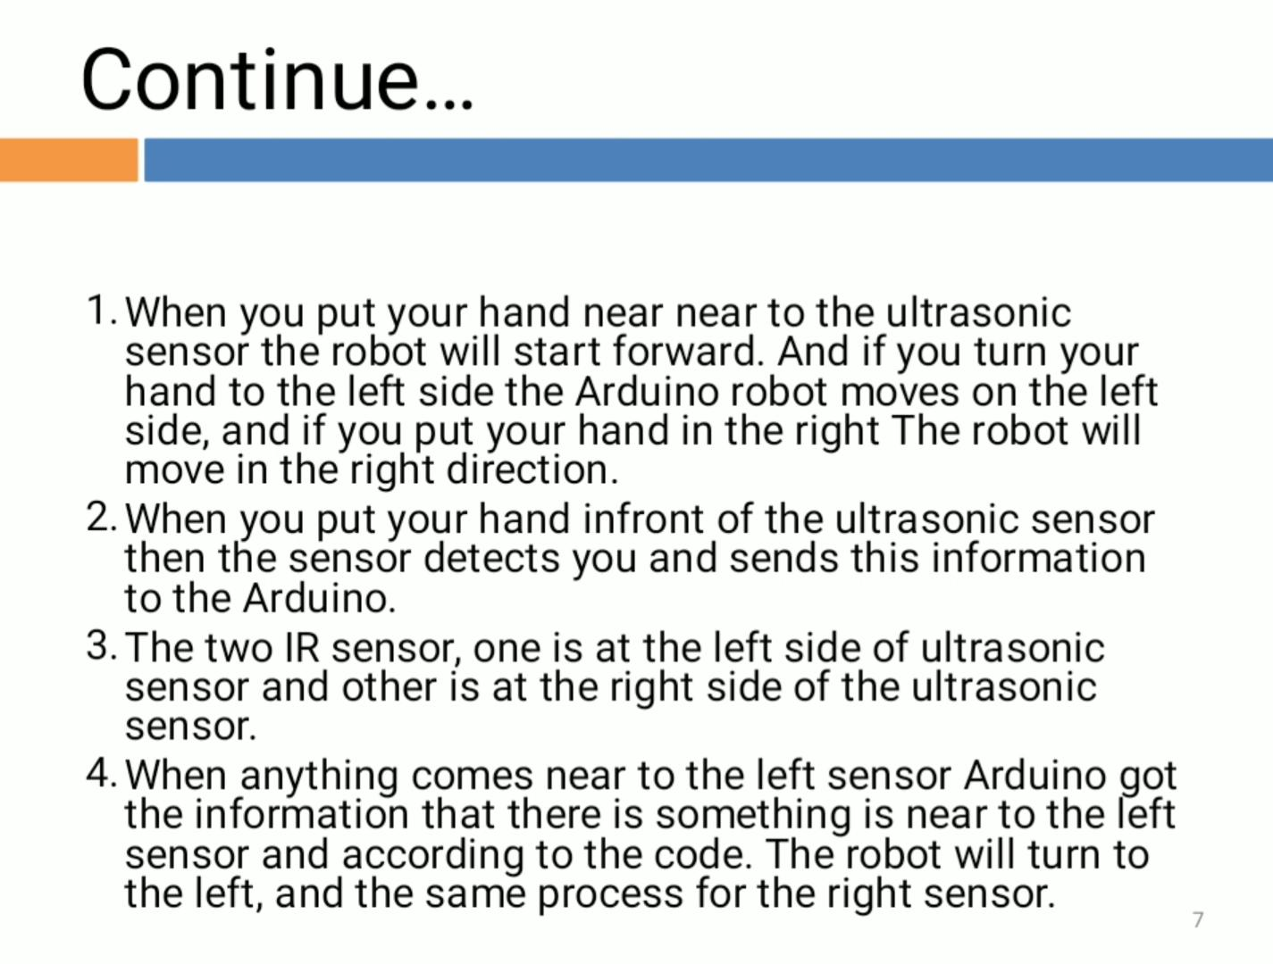
implementation
Find the individual stiffness matrix for each element given in question. ​
Then combine those matrices to form a Global stiffness matrix.
3. Then multiply the Global stiffness matrix with nodes matrix and equate that final matrix with F matrix.
Where, F= force vectors matrix.
K = Flobal Stiffness matrix.
Q = nodes matrix.
4. Then by GAUSS elimination method , eliminate the row and column with respect to the fixed node.​
5. Then form the equations from remaining matrices of F, K and Q.
6. ​Solve that equations with the help of scientific calculator. And our answer for displacement of each node will be ready.

Slide 8

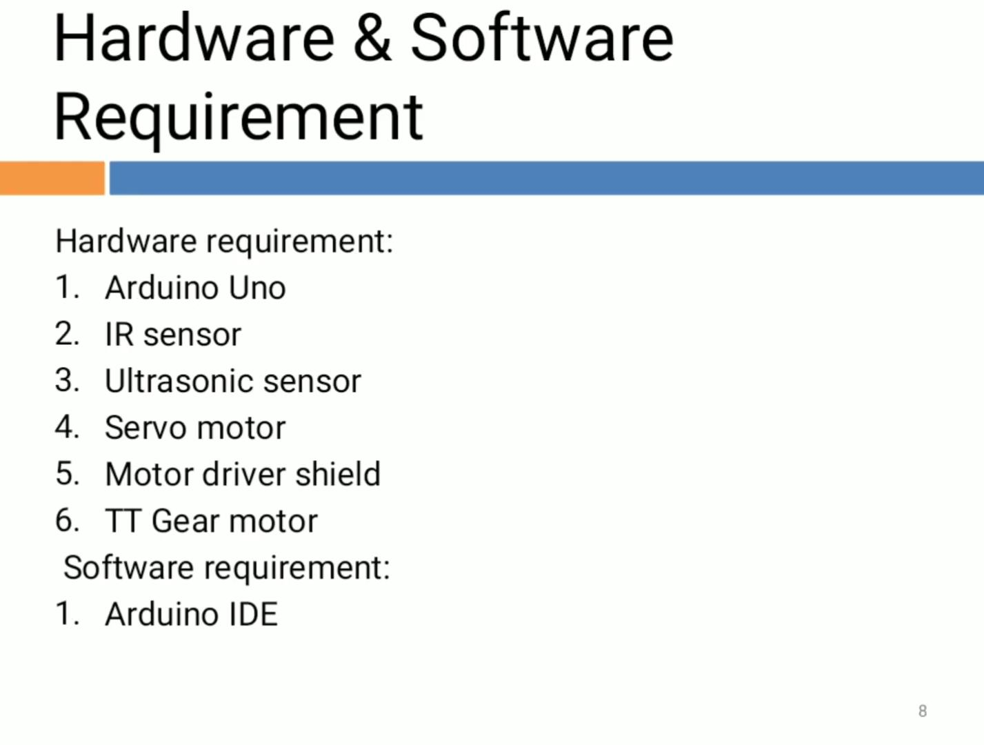

Slide 9
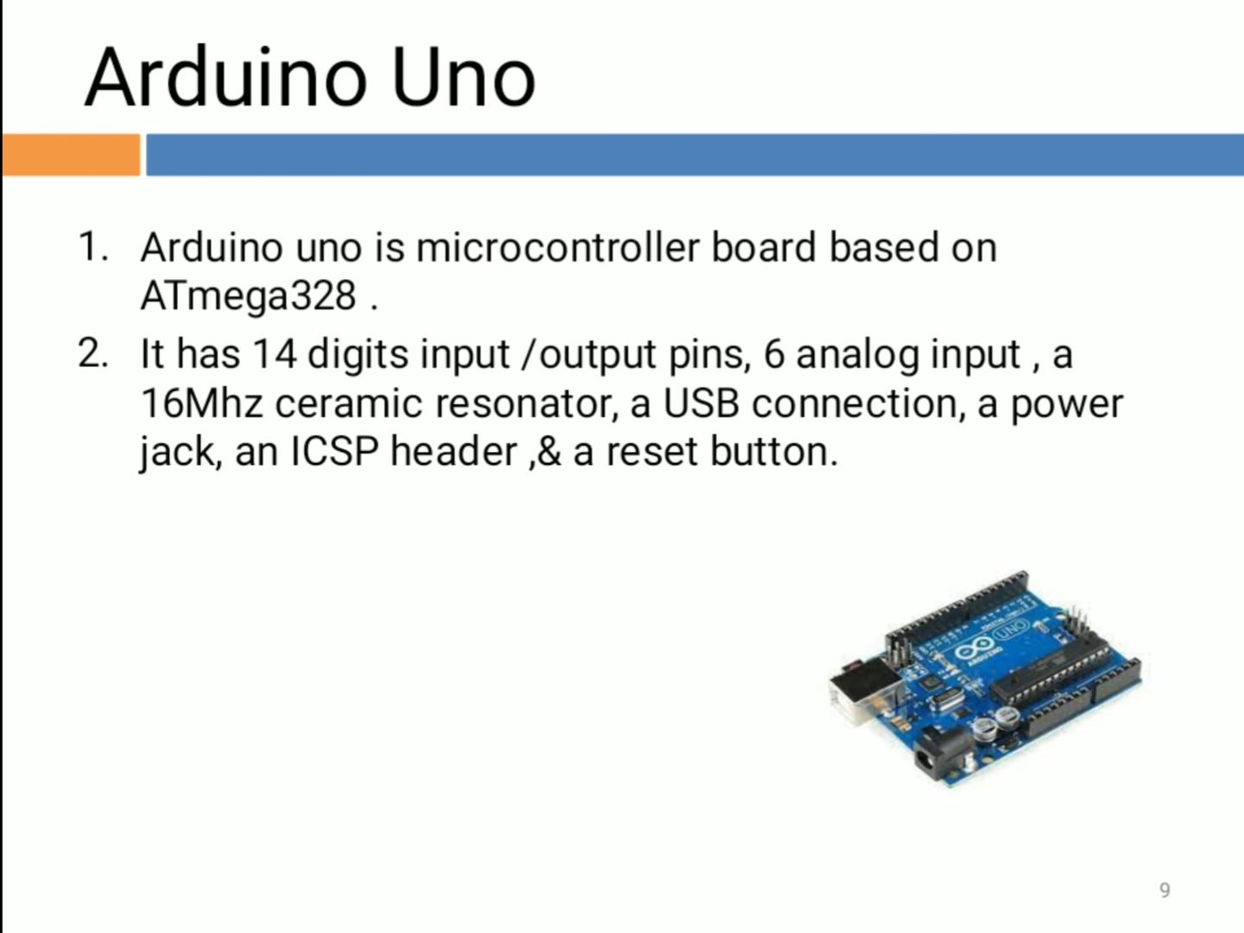

Slide 10
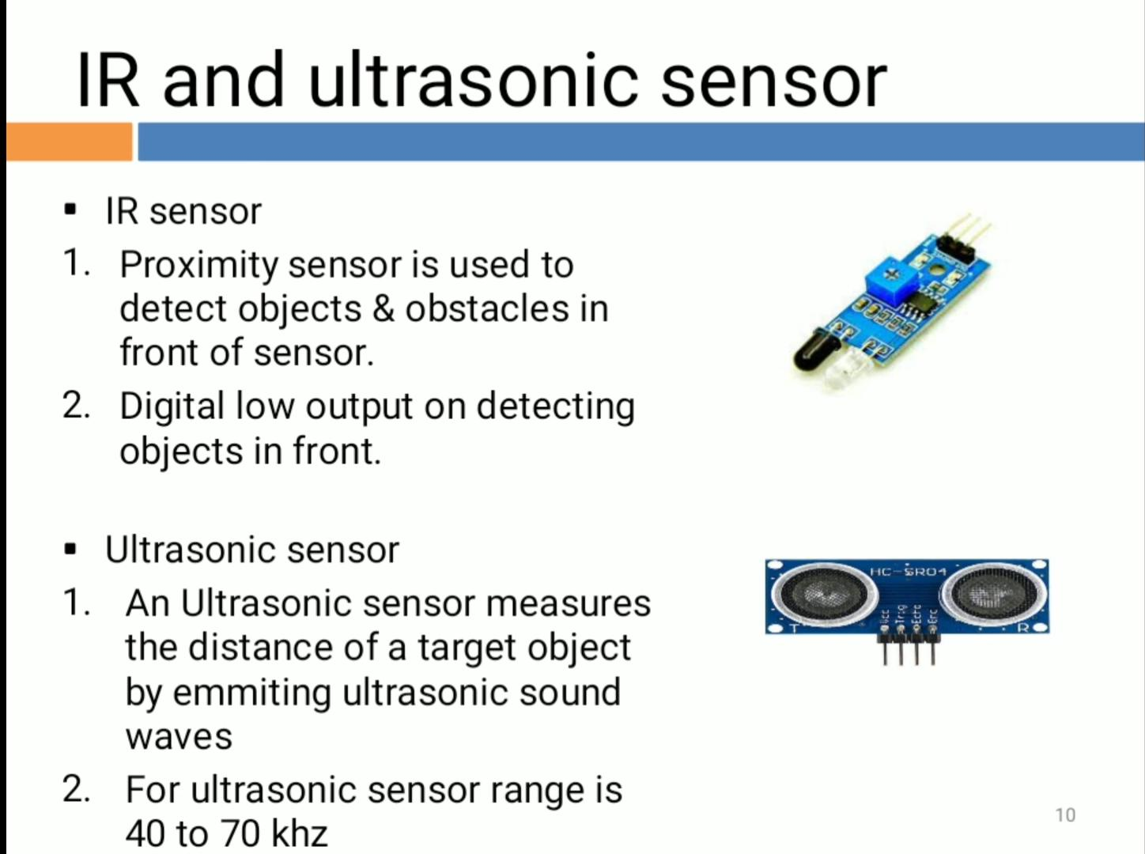

Slide 11
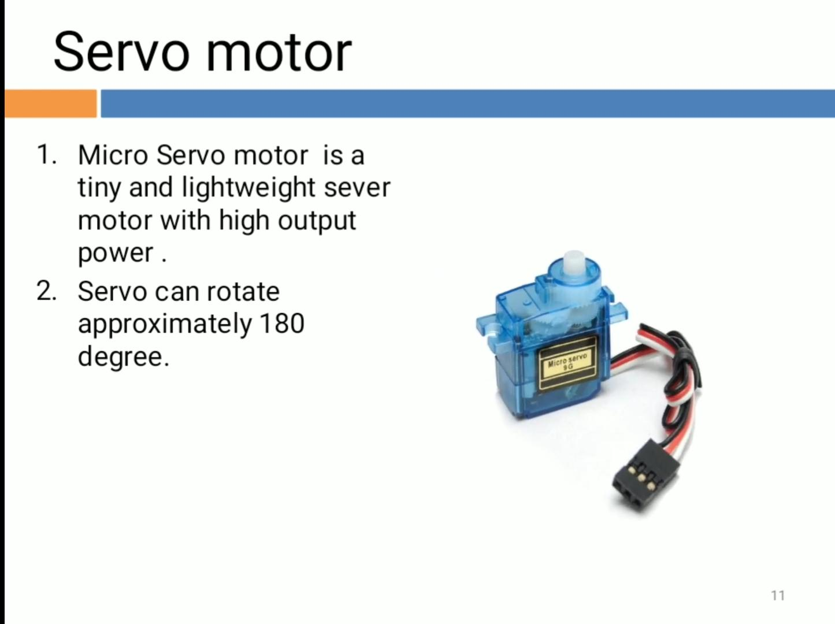

Slide 12
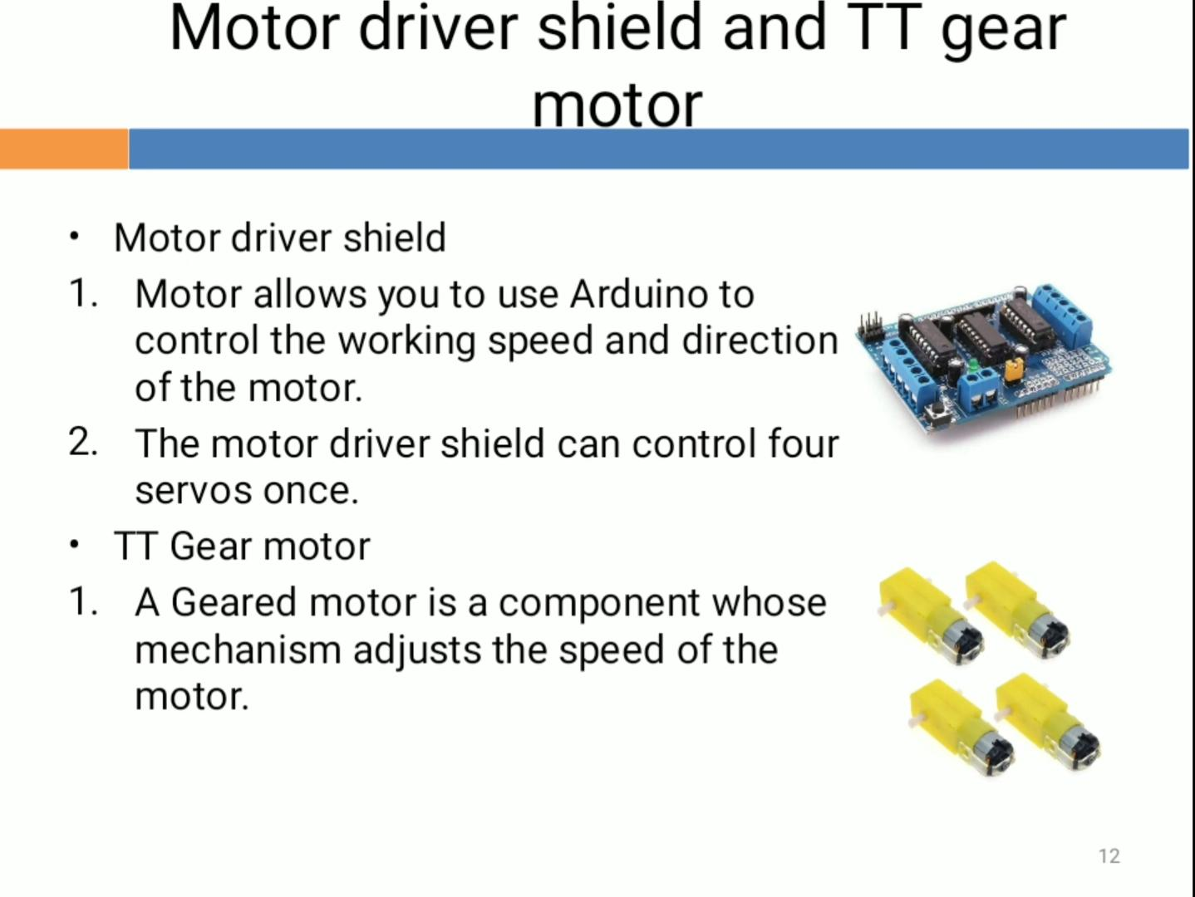

Slide 13
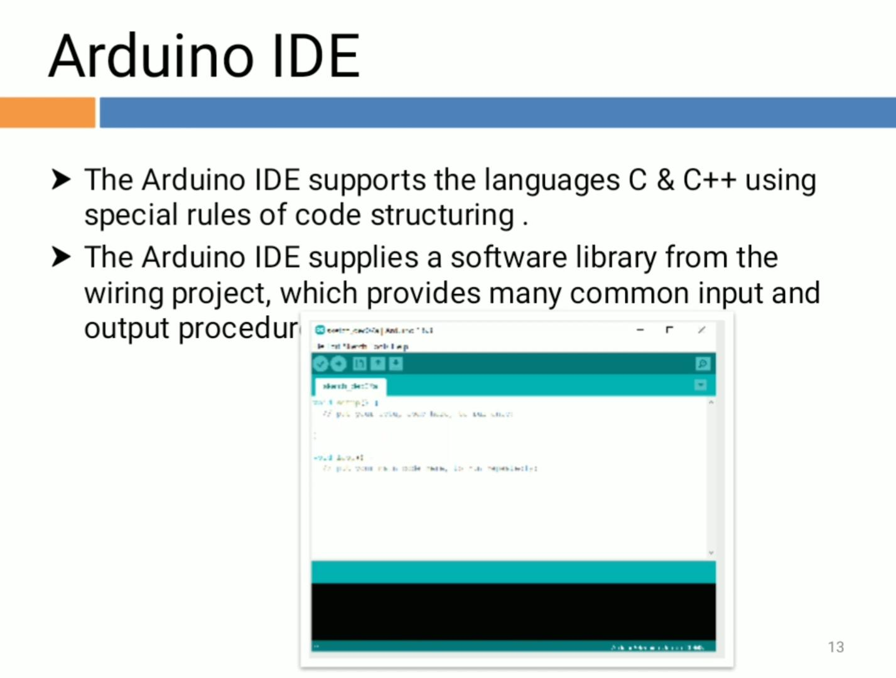

Slide 14
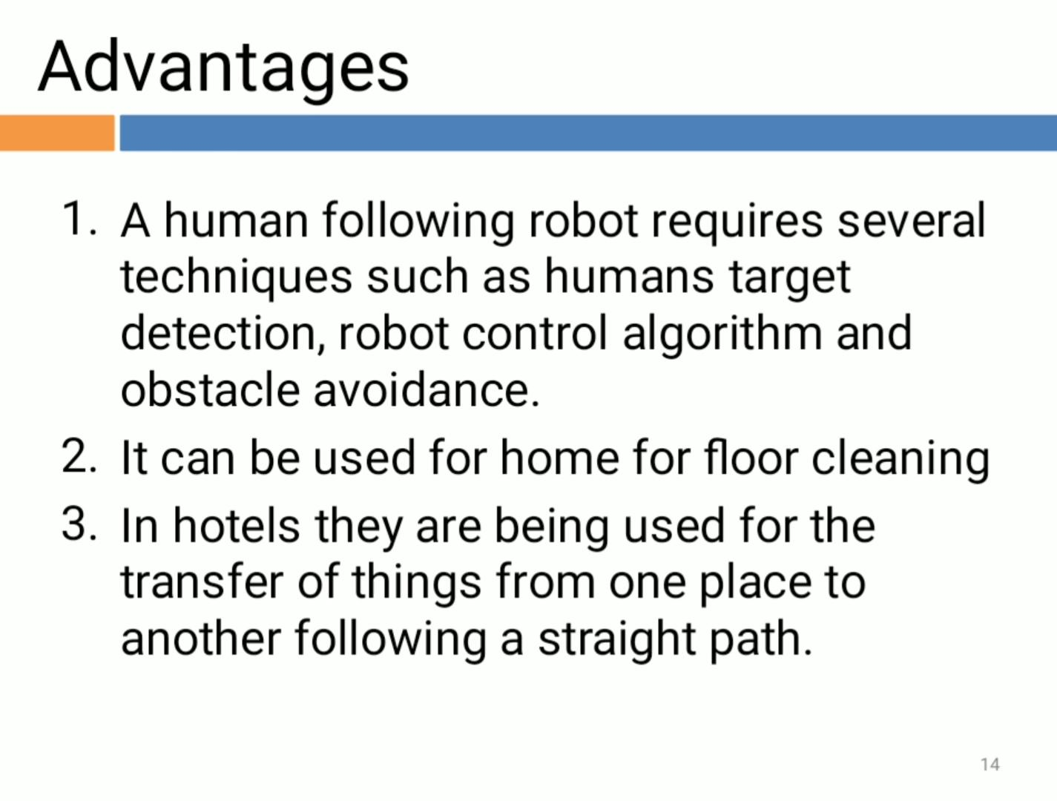

Slide 15
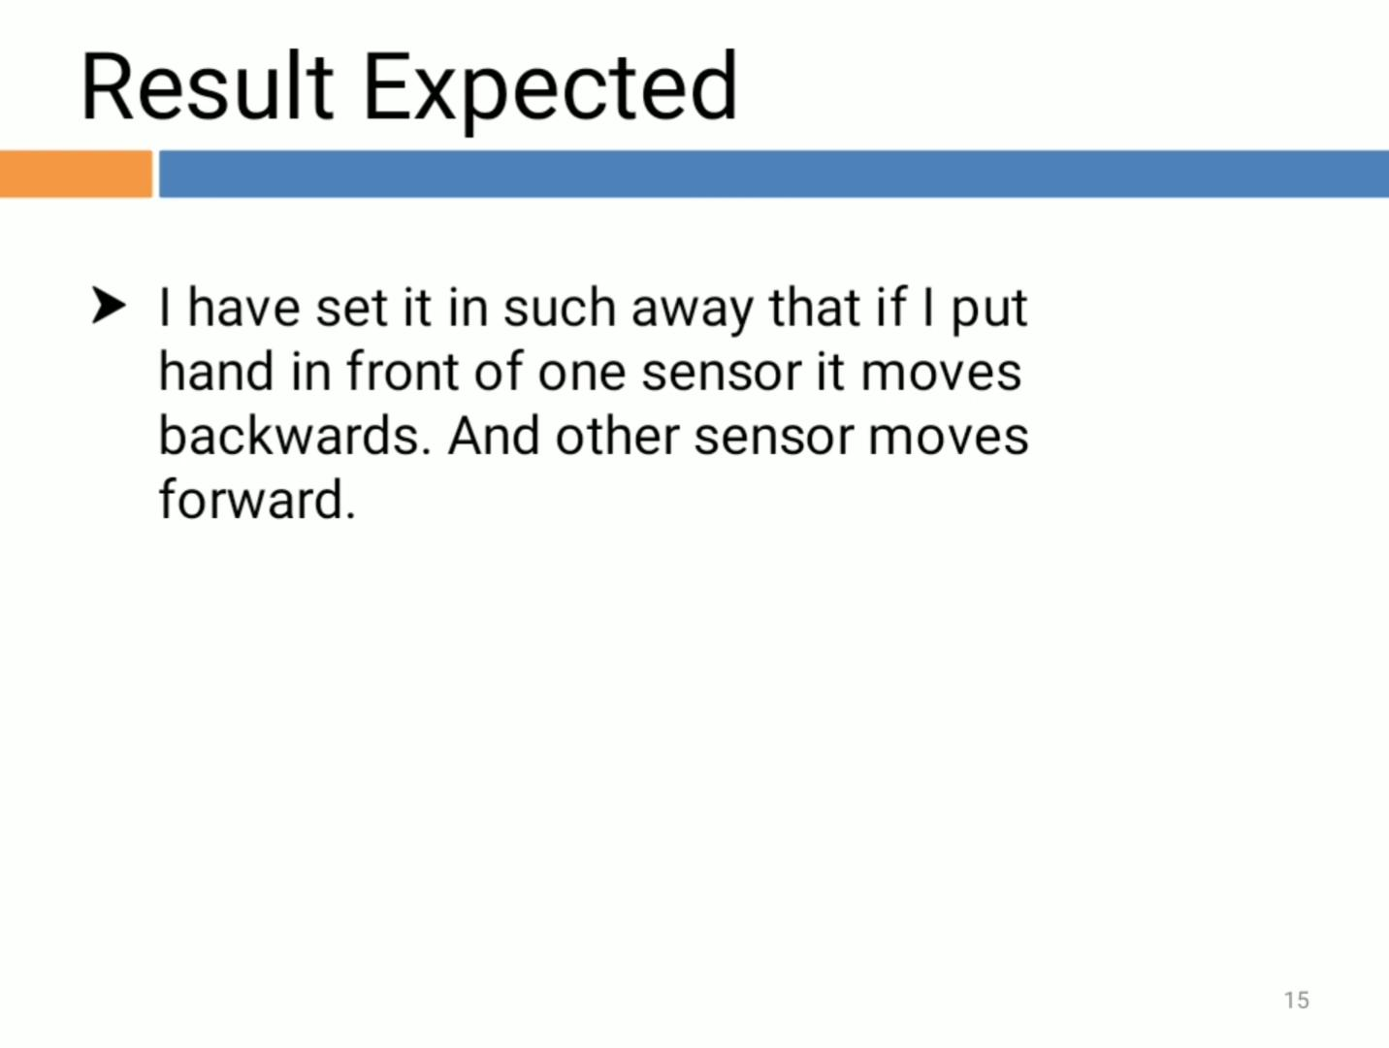

Slide 16
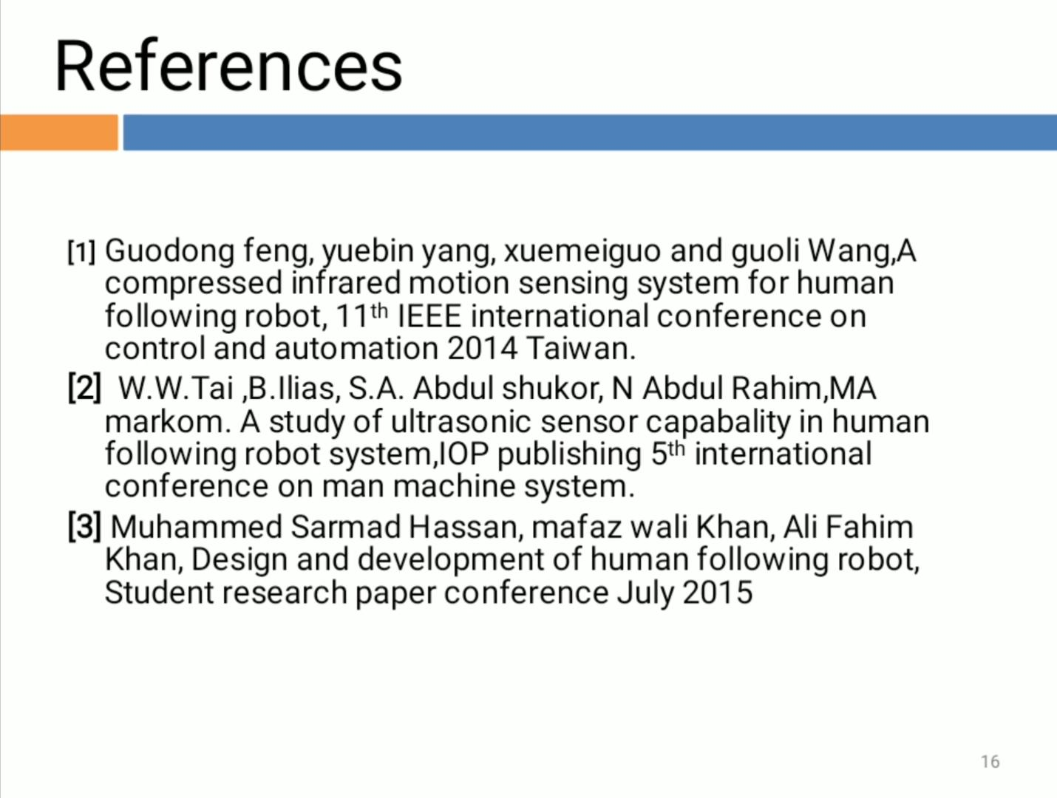

Slide 17


Slide 18


